Slide 1


SMART INDIA HACKATHON 2025
Problem Statement ID - 25050
Problem Statement Title - Smart Traffic Management System for Urban Congestion
Theme - Transportation & Logistics
PS Category - Software
Team ID -
Team Name - AlgoRangers

Slide 2
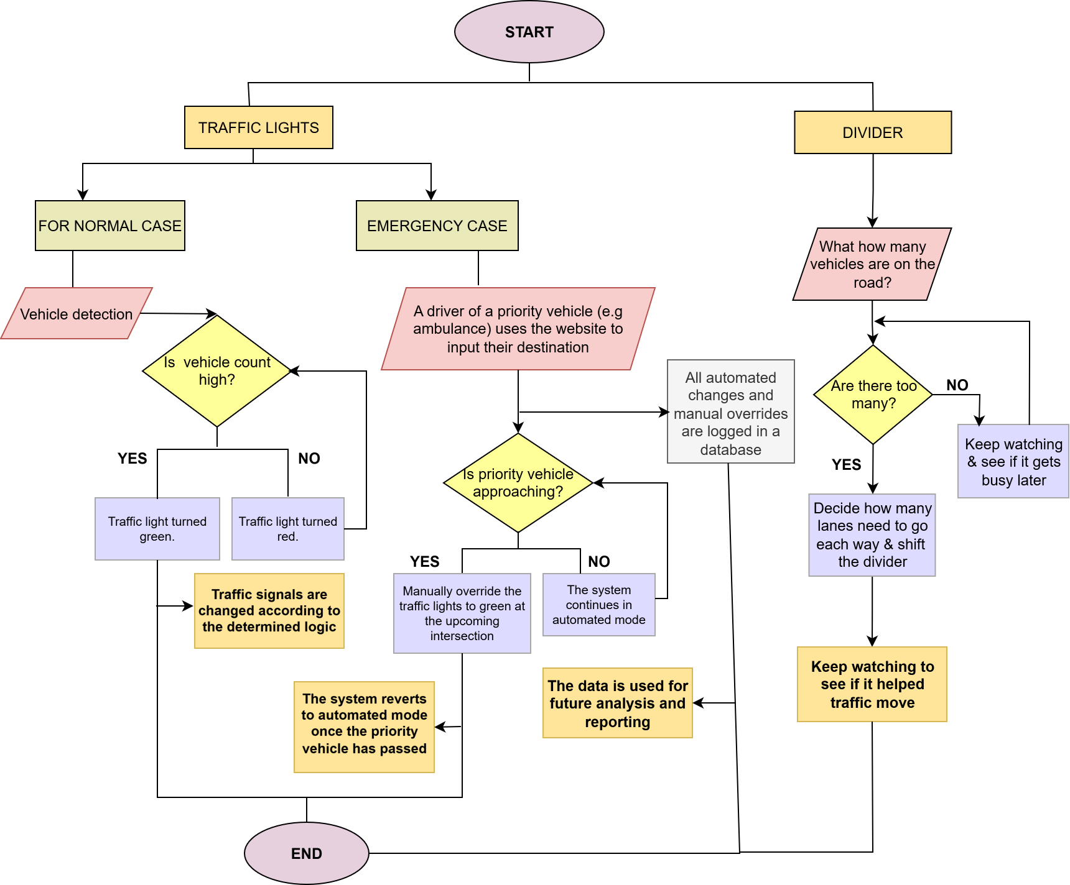
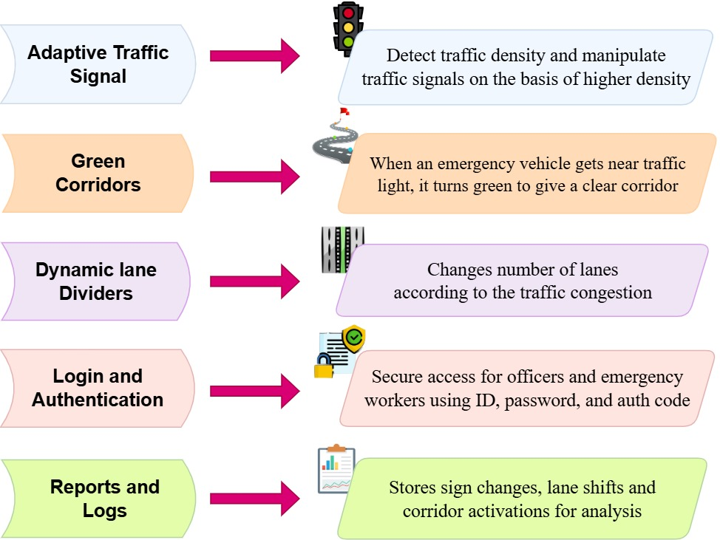
URBANFLOW
AlgoRangers
Proposed Solution

Slide 3
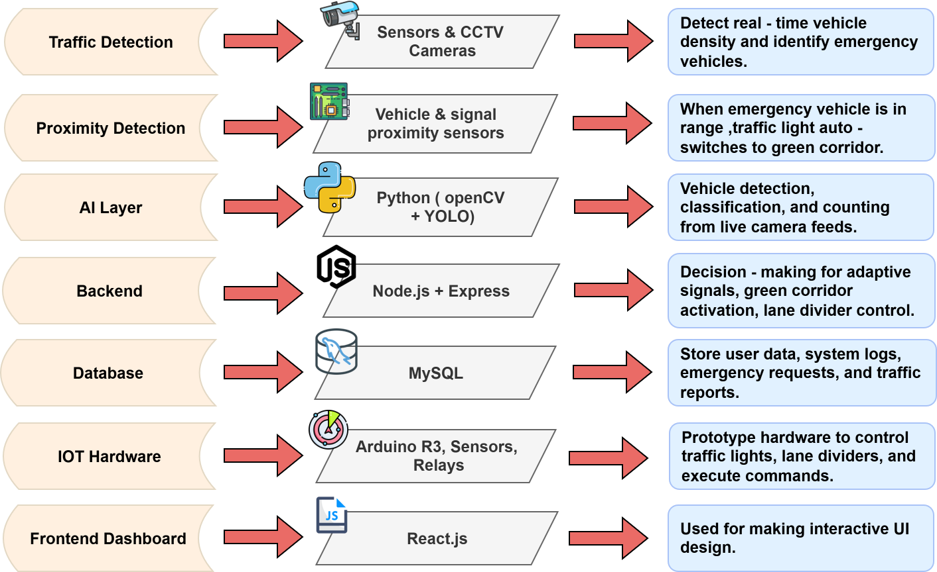
TECHNICAL APPROACH
AlgoRangers

Slide 4
FEASIBILITY AND VIABILITY
AlgoRangers
Feasibility
Technical : AI + IOT feasible; moving dividers complex.
Economic : Medium – high cost, but long-term benefits.
Operational : Needs training, maintenance, and a fallback system.
Environmental : Less carbon emissions.
Challenges & Risks
Sensor/AI failures, network downtime.
High initial setup & maintenance cost.
Technically skilled manpower needed.
Divider system is expensive & complex and needs new infrastructure.
Strategies
Pilot rollout : phased scaling.
Redundancy & fallback timers.
Government funding support.
Training + SOPs for staff.

Slide 5
IMPACT AND BENEFITS
AlgoRangers
IMPACTS
Reduced Travel Time: Smoother flow
Fuel Efficiency: Less idling, lower the fuel consumption
Lives Saved: Faster emergency services
Environmental Benefits: Reduced carbon emissions.
Economic Growth: Saves lakhs of rupees in fuel costs annually for citizens due to less idling.
Citizen Satisfaction: Stress-free travel
Smart city: Roads are efficiently used
BENEFITS
Efficient, flexible, and smart traffic management.
Cost saving (less fuel consumption -> less import duties for the nation annually).
Emergency services will reach faster, resulting in saving more lives and property.
Public satisfaction & trust in smart city systems.
Operational Cost Savings for Government

Slide 6
RESEARCH AND REFERENCES
AlgoRangers
Category
Examples and References
Chennai implementations:-
https://timesofindia.indiatimes.com/city/chennai/ai-driven-adaptive-signals-to-cut-wait-times-at-165-junctions/articleshow/123103169.cms?utm_source=chatgpt.com
Adaptive Signals
Emergency control system:-
https://www.ijraset.com/research-paper/iot-enabled-smart-traffic-management-and-alert-system? utm_source=chatgpt.com
Emergency Prioritization
IOT + ML movable dividers research:-
https://iarjset.com/papers/automatic-movable-smart-road-divider-using-iot/?utm_source=chatgpt.com https://www.pices-journal.com/ojs/index.php/pices/article/view/241?utm_source=chatgpt.com
Dynamic Lane Dividers

